Slide 1

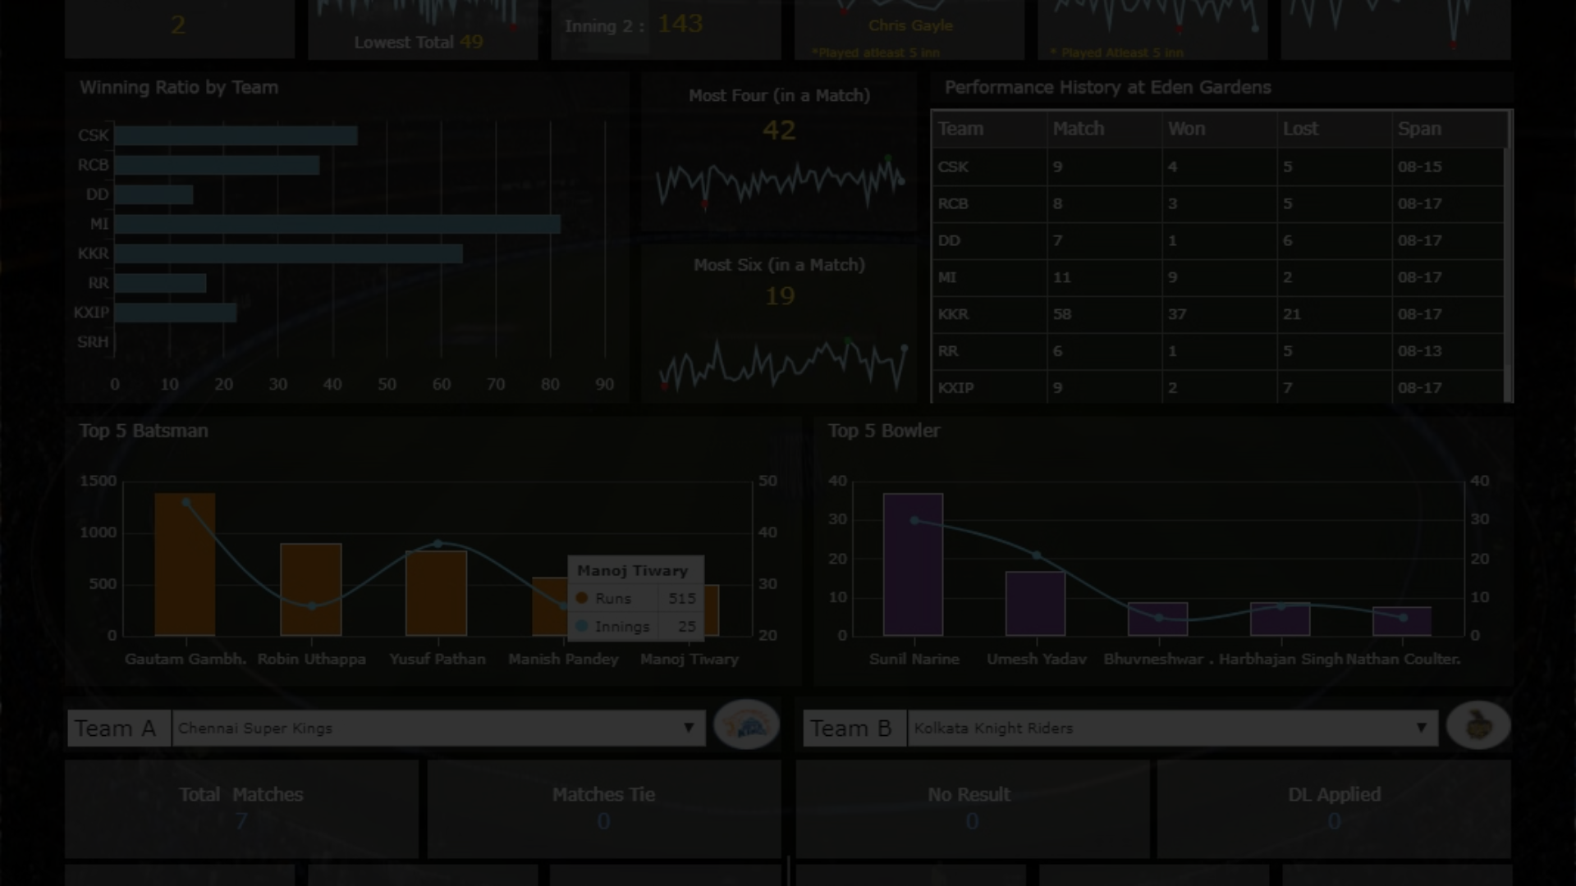
Benefits of Visualizing IPL Data
Discover the power of visual data representation in understanding and analyzing IPL statistics.
Player Performance Analysis: Visualizing individual player statistics helps in tracking performance trends over time, aiding teams in selection decisions and strategic planning.
Team Comparison: Graphical representations allow for easy comparison of team performance in batting, bowling, and fielding metrics, aiding in identifying strengths and weaknesses.
Match Dynamics Understanding: Real-time or post-match visualizations, like heatmaps, illustrate scoring patterns and strategic decisions, enhancing understanding of match dynamics for fans and analysts.
Fan Engagement: Engaging visualizations, such as infographics and interactive dashboards, enhance fan experience by presenting statistics and insights in an accessible format, fostering a deeper appreciation for the game.

Slide 2
Key Insights from IPL Data Visualizations
1
Enhanced Understanding
2
Pattern Recognition
3
Comparative Analysis
Visualizations provide deeper insights into player performance and team trends.
Spot trends and patterns within IPL data for strategic decision-making.
Effortlessly compare player statistics and team performance visually.

Slide 3

How to Access and Use Our IPL Data Visualization Tool
Accessing the Tool
Utilizing Features

Slide 4
Case Studies: Real-World Examples of IPL Data Visualizations
In-Depth Player Analysis
Strategic Team Visualizations
Illustrative case studies showcasing the impact of visualized player data.
Real-world applications of data visualizations for team performance and strategy.

Slide 5



Conclusion and Next Steps
Reflection
Summarize the key takeaways and insights from our IPL data visualization tool.
Further Exploration
Discover more about the possibilities and advancements in cricket data visualizations.

